Slide 1
Women and Cardiovascular Disease
Blake Wachter, MD, PhD
Idaho Heart Institute

Slide 2
Women and Heart Disease
Epidemiology
Women vs Men
Who is at Risk?
15 Year Awareness Study in Women
10 Things to Know About Stroke
Know the Signs and Symptoms of a Heart Attack
CVD Prevention
The Salt Talk

Slide 3
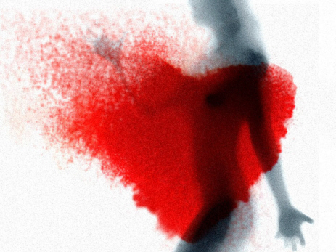
Just the facts ma’am
42.9 million women currently have cardiovascular disease
2.6 million have a history of a heart attack
More women than men die of a cardiovascular disease each year
26% of women > 45 yo vs 19% of men > 45 yo will die within 1 year of symptoms
47% of women vs 36% of men will die within 5 years of symptoms
18% of women vs 8% of men will have heart failure within 5 years
64% of women vs 50% of men who die suddenly had no prior symptoms
Rate of death of women has been increasing while rate of death in men have been decreasing

Slide 4
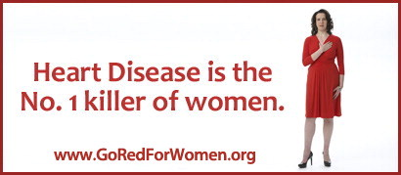
Sobering facts
Cardiovascular disease (CVD) is the leading cause of death of American women.
1 in 3 female deaths in US from CVD
1 in 31 females die annually from breast cancer
CVD causes about 1 death per minute in women in 2009
During this lunch hour presentation: 60 women will have died from CVD
54,636 women die each year from heart attacks

Slide 7
Who is at risk?
Cigarette smokers 2 – 4 x more likely to develop heart disease
Total cholesterol > 200 mg/dL
Poor physical activity
Overweight to obese (BMI > 25)
Diabetics have a 2.2 fold higher risk of dying from CVD compared to women without DM.
(men 1.7 fold higher risk of dying from CVD compared to men without DM)

Slide 8
AHA Special Report Fifteen-Year Trends in Awareness of Heart Disease in Women Results of a 2012 American Heart Association National Survey
Circulation, Feb 2013

Slide 9
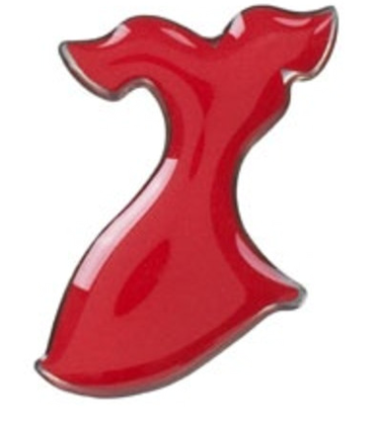
AHA Initiatives
In 1997, the American Heart Association (AHA) commissioned a national survey to assess the awareness and knowledge of heart disease risk among women
In response to the national data showing that only 1 in 3 women correctly identified heart disease as their leading cause of death, the AHA launched a national campaign to raise awareness and to educate the public about the hazards of heart disease in women
in 2003, the AHA named its national initiative Go Red for Women
The Red Dress has become the national symbol of the heart disease

Slide 10
1997 vs 2012 – we are getting better
1 in 3 women correctly identify heart disease as their leading cause of death
Younger women tend NOT to discuss heart disease risk factors with their doctors
21% reported that their doctor discussed heart disease risk factors
Barriers to care:
Too busy, family obligations, already lead a healthy life style (not to worry), no insurance
Women tend to comprise only about 25% of population of heart disease studies

Slide 11
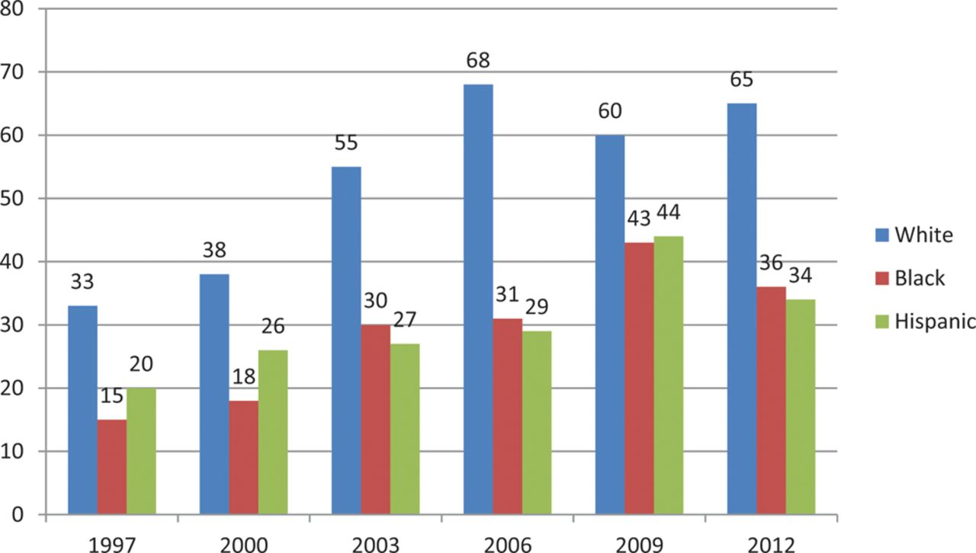
Trends in awareness that heart disease is the leading cause of death in women.
Mosca L et al. Circulation. 2013;CIR.0b013e318287cf2f
Copyright © American Heart Association, Inc. All rights reserved.
Notes:
Trends in awareness that heart disease is the leading cause of death in women.

Slide 12
So if awareness is improving, why are more women dying?
Obesity epidemic
Increase in co-morbidities
Diabetes
Hypertension
Smoking
Hyperlipidemia
More women than men have HTN over the age of 65
2 of 3 women are overweight or obese

Slide 13
So if awareness is improving, why are more women dying?
More women compared to men die from stroke
Due to hormone replacement therapy, pregnancy, HTN
Migraines, obesity, oral contraceptives
Class III: Hormone replacement should not be used as a primary prevention of CVD
Women with autoimmune disease have a higher prevalence of CVD
Preeclampsia may be an early indicator of CVD
Effectiveness-Based Guidelines for the Prevention of Cardiovascular Disease in Women—2011 Update: A Guideline From the American Heart Association. Circulation 2011;Feb 16

Slide 14
Stroke is a Cardiovascular Disease

Slide 15
Know the signs of a stroke
• Sudden numbness or weakness of the face, arm or leg, especially on one side of the body
• Sudden confusion, trouble speaking or understanding
• Sudden trouble seeing in one or both eyes
• Sudden trouble walking, dizziness, loss of balance or coordination
• Sudden, severe headache with no known cause

Slide 16
Risk factors for stroke
Hypertension
Goal < 140/90
Tobacco use
Diabetes mellitus
High cholesterol
Physical inactivity and obesity
Carotid artery disease
Atrial fibrillation
Transient ischemic attacks (TIAs)
Certain blood clotting disorders
Excessive alcohol use
Illegal drug use
Age
Gender
more men than women have stroke, but more women die from stroke
Hereditary / race
Hispanic and African Americans
Prior stroke

Slide 17
Top Ten Things To Know AHA Heart Disease and Stroke Statistics – 2012 Update
1. Declines in stroke death rates now rank stroke as the 4th leading cause of death.
2. From 2007 to 2008, the cost of CVD (stroke and heart) increased by over $11 billion.
3. Hypertension - An estimated 76.4 million U.S. adults ≥20 years of age are hypertensive.
4. Cholesterol - An estimated 98.8 million adults ≥20 years of age have total serum cholesterol levels ≥200 mg/ dL; 33.5 million have total serum cholesterol levels ≥240 mg/dL.
5. Diabetes - An estimated 18.3 million Americans ≥20 years of age have physician-diagnosed diabetes. An additional 7.1 million adults have undiagnosed diabetes and about 81.5 million adults have prediabetes.

Slide 18
Top Ten Things To Know AHA Heart Disease and Stroke Statistics – 2012 Update
6. Physical Activity - Only 20.7% of adults meet the federal guidelines for physical activity. Among 9 through 12 graders, only 37.0% meet the recommendations.
7. Healthy Diet – Less than 1% of U.S. adults meet the definition for ―Ideal Healthy Diet; essentially no children meet the goal.
8. Smoking - 19.8% of boys and 19.1% of girls in grades 9-12 report being current smokers. Among adults, 21.2% of men and 17.5% of women over age 18 years are smokers.
9. Body Mass Index - Overall, 68% of U.S. adults are overweight or obese (72% of men and 62% of women). Thirty-two percent of children ages 2-19 are overweight or obese (32% of boys and 31% of girls).
10. There are improvements in CVD and stroke mortality, improvements of prevalence of high cholesterol and physical activity;
BUTno changes in prevalence of hypertension and smoking and worsening of prevalence of diabetes and overweight.
Roger VL, et al; on behalf of the American Heart Association Statistics Committee and Stroke Statistics Subcommittee. Heart disease and stroke statistics—2012 update: a report from the American Heart Association. Circulation. 2012: published online before print December 15, 2011, 10.1161/CIR.0b013e31823ac046. http://circ.ahajournals.org/lookup/doi/10.1161/CIR.0b013e31823ac046

Slide 19
Know the Signs of a Heart Attack

Slide 20
Know the signs
Uncomfortable pressure, squeezing, fullness or pain in the center of your chest. It lasts more than a few minutes, or goes away and comes back.
Pain or discomfort in one or both arms, the back, neck, jaw or stomach.
Shortness of breath with or without chest discomfort.
Other signs such as breaking out in a cold sweat, nausea or lightheadedness.
As with men, women’s most common heart attack symptom is chest pain or discomfort.
Women, like men, can experience some of the other symptoms, particularly shortness of breath, nausea/vomiting and back or jaw pain without chest pain.

Slide 21
CVD Prevention

Slide 22
CVD Prevention
Know the signs of stroke and heart attack – AND GET HELP
Don’t smoke
Control HTN
Control DM
Physical activity
Healthy diet
Control weight, goal BMI < 25
Control lipids

Slide 23
CVD Prevention – Do Nots
Antioxidant vitamin supplements and folic acid should not be used for the primary or secondary prevention of CVD.
Routine use of aspirin in healthy women <65 years of age is not recommended for primary prevention of myocardial infarction.
Hormone replacement should not be used as a primary prevention of CVD

Slide 24
The Salt Talk

Slide 25
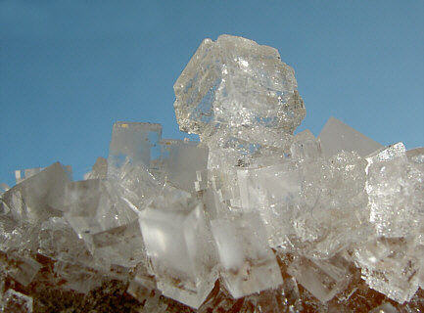
Salt
Salt is a mineral substance composed primarily of sodium chloride (NaCL)
Salt in its natural form as a crystalline mineral is known as rock salt or halite
Salt is essential for life and saltiness is one of the basic human tastes.
Salt is one of the oldest and most ubiquitous of food seasonings, and is important for preserving / curing foods.
Salt naturally occurs in many foods

Slide 26
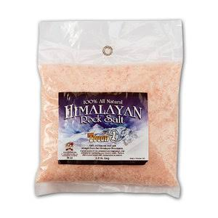
Salt, a good thing?
Some table salt sold for consumption contain additives which address a variety of health concerns, especially in the developing world.
Iodine: prevention of endemic goiter in adults and cretinism in children (since 1924)
Iodine deficiency affects 2 billion people and is the leading preventable cause of mental retardation.
Fluoride: goal of reducing tooth decay. Common in some European countries (France).
Double fortified (iodine and iron +/- folic acid): prevents iron deficiency anemia, folic acid in pregnant women to prevent neural tube defects.
Unrefined sea salt has magnesium, calcium halides, and sulphates, as well as traces of algal products, bacteria and other sediments. All of these give the salt a more complex flavor.

Slide 28
Which has more salt?
Tobasco sauce or ketchup ?
Steak seasoning or soy sauce?
Potato chips or 1 cup of tomato juice?
French fries or the fast food hamburger?
Lean cuisine meal or healthy choice chicken soup?
Table salt or raw sea salt?

Slide 29
Food | Sodium
1 teaspoon of salt | 2325mg
Fast food hamburger/chicken sandwich | 1600mg – 2000mg
French fries (5 Guys Small) | 200mg
1 cup tomato juice | 1000mg
1 tsp of Tobasco | 28mg
¾ tsp of steak seasoning | 560mg
1 Tbs of ketchup | 150mg
1 tsp soy sauce | 900 mg
1 oz potato chips | 250mg
Lean Cuisine Meal | 500 – 650mg
Healthy choice chicken soup | 380mg (per serving)

Slide 30
Salty Facts
Body needs only 200mg sodium / day
Average American diet has > 3600mg / day
75% of salt consumed comes from processed food (not the table salt)
Kosher salt and sea salt have the same sodium content as traditional table salt
The major health organizations recommend that we cut back on sodium:
American Heart Association (AHA): 1500 mg (3).
American Diabetes Association (ADA): 1500 to 2300 mg.

Slide 31
What do we get?
In a massive Cochrane review of 34 randomized controlled trials, salt restriction was shown to reduce blood pressure
Individuals with elevated blood pressure: A reduction of 5.39 mm Hg systolic and 2.82 mm Hg for diastolic.
Individuals with normal blood pressure: A reduction of 2.42 mm Hg systolic and 1.00 mm Hg for diastolic.
Better heart failure (systolic and diastolic) volume control
Overall sense of feeling better

